Slide 1
Chapter 3: An overview of project planning
Part 1
NET481: Project Management

Slide 2
Topics to be covered
Project Planning in an organized step by step manner
Different techniques and how they are fit into an overall planning approach
The need to repeat the planning process in more details for some activities within a project before execution

Slide 3
Planning Activities‭ ‬Steps
Step 0‭: ‬Select project‭
Step 1‭: ‬Identify project scope and objectives
Step 2‭: ‬Identify project infrastructure
Step 3‭: ‬Analyze project characteristics‭
Step 4‭: ‬Identify project products and activities‭
Step 5‭: ‬Estimate effort for each activity‭

Slide 4
Planning Activities‭ ‬Steps (cont.)
Step 6‭: ‬Identify activity risks‭
Step 7‭: ‬Allocate resources‭
Step 8‭: ‬Review/publicize plan‭
Step 9‭: ‬Execute plan
Step 10‭: ‬Execute lower levels of planning‭

Slide 5
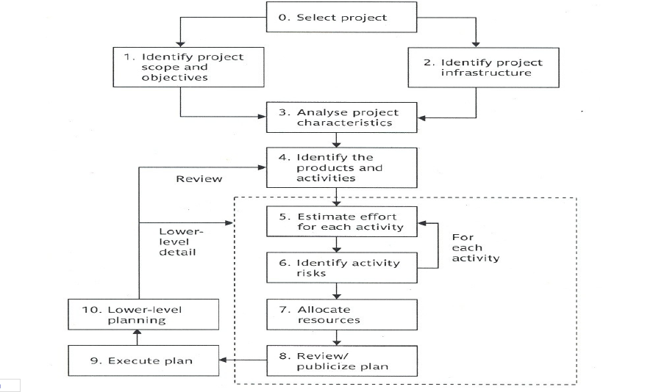
An overview of step wise

Slide 6
Step 0: Select Project
This is called step 0 because in a way it is outside the main project planning process.

Slide 7
Step 1: ‬Identify Project Scope and‭ Objectives
Step 1.1‭ ‬Identify objectives and practical measures of the‭
effectiveness in meeting those objectives‭.
Correct definition of objectives‭.
Identify measures of effectiveness for your objectives‭.
Measures of effectiveness provides practical methods‭ of checking that an
object has been met.
Ex‭: ‬measuring reliability‭:
Mean time between failures‭. (‬Performance measure‭)
Number of errors found during code inspections‭.‬ (‬Predictive measure‭)

Slide 8
Step 1‭ (cont.)
Step 1.2‭ ‬Establish a project authority‭.
To ensure the unity of purpose among all persons concerned‭.
The project authority is usually‭:
A project steering committee
‬A project board or project management board‭
The project authority have overall responsibility for setting‭,
monitoring and modifying objectives‭.
The project manager runs the project but reports regularly to the
steering committee‭

Slide 9
Step 1‭ (cont.)
Step 1.3‭ ‬Identify all stakeholders in the project and their interests.‭
Step 1.4‭ ‬Modify objectives in the light of stakeholder analysis
Based on the stakeholders requirements‭, ‬it might be necessary to modify the
project objectives‭.
‬ E.g.‭. ‬Adding new features to the system‭.
This has to be done in a controlled manner‭.

Slide 10
Step 1‭ (cont.)
Step 1.5‭ ‬Establish methods of communication between all‭ parties
Communication between stakeholders is important in all kinds of projects
It is more important to arrange for in a dispersed project‭.
the way stakeholders will communicate is part of the‭ project planning

Slide 11
Step 1‭ (cont.)
There has to be a communication plan‭:
List the main stakeholders‭.
With special attention to those involved in the‭
development and implementation‭.
List their concerns‭.
Identify suitable methods for effective communication
consulting stakeholder’s representatives would be a‭ help

Slide 12
Step 1‭ (cont.)
The communication plan could be documented in a table
with‭ the following headings:
What‭? ‬ Name of the meeting‭.
Who‭? Target audience‭.
Purpose‭. ‬
When/frequency‭?
Type/method‭?
E.g‭. ‬Meeting or a document distribution‭.
Responsibility‭.
the person initiating the meeting‭.

Slide 13
Step 2: Identify Project Infrastructure
Step 2.1‭ ‬Identify relationship between the project and strategic
Planning
Select the projects to be carried out by an organization‭. ‬
Project portfolio
Programme management‭.
managing a group of projects together in a coordinated way
It can ensure that a group of projects contribute to a common
organizational strategy

Slide 14
Step 2‭ (cont.)
Establish a framework within which the system fits‭.
hardware and software standards should be followed‭.
The software or components to be created should be
compatible with those created by previous projects and with
the existing HW and SW platforms‭.

Slide 15
Step 2‭ (cont.)
Step 2.2‭ ‬Identify installation standards and procedures‭.
Identify standards and procedures related to the software
project
E.g‭. ‬specifying quality checks needed at each point of the project
Life cycle
The project manager should be aware of the Project planning
and control standards‭.
E.g how are hours spent by team members on tasks recorded on‭ ‬
timesheets.

Slide 16
Step 2‭ (cont.)
Step 2.3‭ ‬Identify project team organization‭.
e.g‭. ‬a high level manager could decide that‭:
software developers and business analysts could be in‭ different
group

Slide 17
Step 3‭: ‬Analyse Project Characteristics
Step 3.1‭ ‬Distinguish the project as either objective-driven or
product-driven‭.
Step 3.2‭ ‬Analyse other project characteristics‭ (‬including‭
quality-based ones‭).
Step 3.3‭ ‬Identify high level project risks‭. ‬

Slide 18
Step 3‭ (cont.)
Step 3.4‭ ‬Take into account user requirements concerning‭
implementation‭.
E.g‭. ‬an organization might mandate the use of a particular
method.
Step 3.5‭ ‬Select general life-cycle approach in the light of the
above‭.

Slide 19
Step 3‭ (cont.)
Step 3.6‭ ‬Review overall resource estimates‭.
Up to this stage‭:
the major risks of the project are identified‭
the overall approach of the project is decided
So‭, ‬it is a good place to re-estimate the required effort and
other resources for the project‭

