Slide 1
Chapter 3: An overview of project planning
Part 2
NET481: Project Management

Slide 2
Topics to be covered
Project Planning in an organized step by step manner
Different techniques and how they are fit into an overall planning approach
The need to repeat the planning process in more details for some activities within a project before execution

Slide 3
Planning Activities‭ ‬Steps
Step 0‭: ‬Select project‭
Step 1‭: ‬Identify project scope and objectives
Step 2‭: ‬Identify project infrastructure
Step 3‭: ‬Analyze project characteristics‭
Step 4‭: ‬Identify project products and activities‭
Step 5‭: ‬Estimate effort for each activity‭

Slide 4
Planning Activities‭ ‬Steps (cont.)
Step 6‭: ‬Identify activity risks‭
Step 7‭: ‬Allocate resources‭
Step 8‭: ‬Review/publicize plan‭
Step 9‭: ‬Execute plan
Step 10‭: ‬Execute lower levels of planning‭

Slide 5
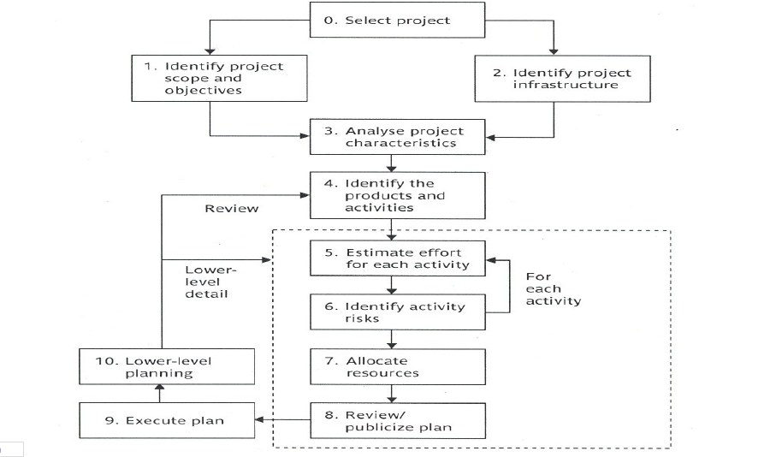
An overview of step wise

Slide 6
Step 4: ‬Identify Project Products and‭ Activities
4.1‭ ‬Identify and describe project products
  Identify all the products related to the project‭
  Account for the required activities‭.
  Products can be‭:
  Deliverables‭. ‬
  ‬Intermediate products‭.
  Technical products‭ (‬e.g‭. ‬training material‭, ‬operating instructions‭).
  Products for management and quality‭ (‬e.g‭. ‬planning documents‭).

Slide 7
Step 4: ‬(cont.)
Products can be‭:
  Created from scratch‭.
  Modified version of something‭.
  Document‭.
  Person.
  Not an activity‭. ‬
  Activity‭
  training‭
  Testing‭
  Designing
  Documenting‭. ‬

Slide 8
Step 4: ‬(cont.)
Products will perform a hierarchy‭:
  Main products will have a set of components which
  in turn will have sub-components and so on‭.
  These relationships can be documented in a
  PBS product breakdown structure.

Slide 9
Product Breakdown Structure‭
    The tangible products are those at the bottom of the PBS
    that‭ are not further subdivided‭.
    The boxes that are higher up are names of group of items‭.
    The products at the bottom of the PBS should be‭
    documented by Product Descriptions‭.
      The name‭, ‬the purpose‭, ‬the derivation of the product‭. ‬
      The composition‭, ‬the form the standards and quality
    criteria of the product‭.

Slide 10
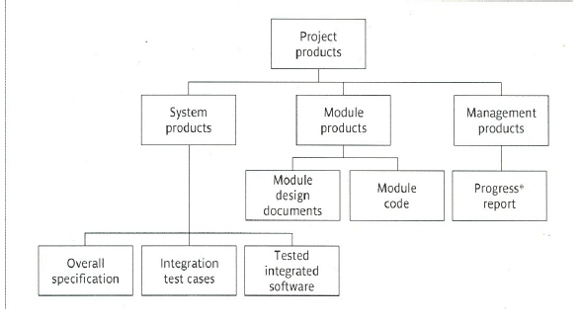
Product Breakdown Structure‭

Slide 11
Step 4: ‬(cont.)
4.2‭ ‬Document generic product flows‭.
  To document the relative order of the products‭.
  Some products will need other products to exist first
before they can be created‭.
E.g‭. ‬the program code to be written need the program
design‭, ‬the program design needs the program
specification
  This can be portrayed in a PFD Product Flow Diagram‭.

Slide 12
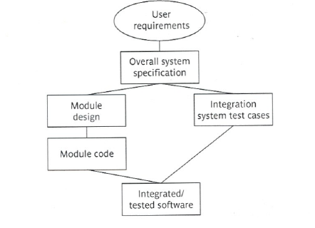
Product Flow Diagram

Slide 13
Step 4:‭ (cont.)
4.3‭ ‬Recognize product instances‭.‭
  Some fragments in the PFD relates to more than one instance of a
  particular type of product‭.
  We should try to identify each of those instances‭.
  e.g‭. ‬there could be only two modules related to the‭ ‬”module product”‭

Slide 14
Step 4:‭ (cont.)
4.4‭ ‬Produce an ideal activity network‭
Activity network shows‭ :
  the tasks that have to be carried out and‭,
  their order of execution for the creation of a product‭. ‬
  Activity networks don’t take account of resource constraints‭. ‬

Slide 15
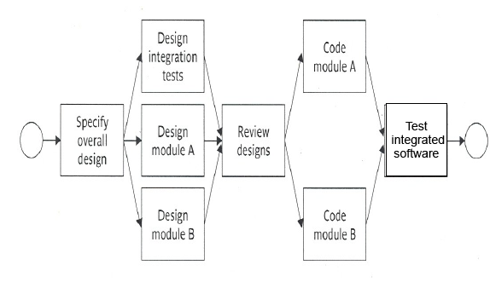
Activity Network Diagram

Slide 16
Step 4:‭ (cont.)
4.5‭ ‬Modify the ideal to take into account need for
stages and checkpoints‭.
Checkpoints:
  To check compatibility of products of previous activities
  Milestones or key activities‭:‭
  Which represent the completion of important stages of the
  project‭

Slide 17
Step 5: Estimate Effort for Each Activity
5.1‭ ‬Carry out bottom-up estimates‭.
  need to estimate staff effort‭, ‬time for each activity‭, ‬and‭ other resources
  ‬
5.2‭ ‬Revise plan to create controllable activities‭.
  Long activity‭: ‬break it down‭.
  Short activity‭: ‬combine multiple small activities into one‭.
  Ideal activity‭: ‬make the activity about the length of the reporting period‭

Slide 18
Step 6‭: ‬Identify Activity Risks
6.1‭ ‬Identify and quantify the risks of each activity‭.
  Any plan is based on an assumption if the assumption is not correct this
  creates a risk to the plan‭. ‬
  For each risk identify‭: ‬
  Importance‭, ‬Likelihood and Damage‭.

Slide 19
Step 6‭: ‬(cont.)
6.2‭ ‬Plan risk reduction and contingency measures where‭
appropriate
  For the identified risks‭:
  If‭ (‬they didn’t happen‭) ‬yet then try to‭:
    Avoid risks‭. ‬
    Reduce some of them‭.
  If a risk materializes‭ (‬happens‭) ‬then‭
    Use a contingency plan‭. ‬
    6.3‭ ‬Adjust overall plans and estimates to take account of risks‭.
    e.g‭. ‬add new activities that will reduce risks‭. ‬ ‬

Slide 20
Step 7‭: ‬Allocate Resources‭ (‬Staffing‭)
7.1‭ ‬Identify and allocate resources‭
  type of staff needed for each activity‭. ‬
  staff availabilities are identified‭. ‬
  staff are provisionally allocated to task‭.
  7.2‭ ‬Revise plans and estimates to take into account
  resource constraints‭.
  staffing constraints‭.
  Gantt charts‭: ‬unlike the activity network they give a clear‭
  picture of when activities will take place and highlights which
  ones will be executed at the same time‭.

Slide 21
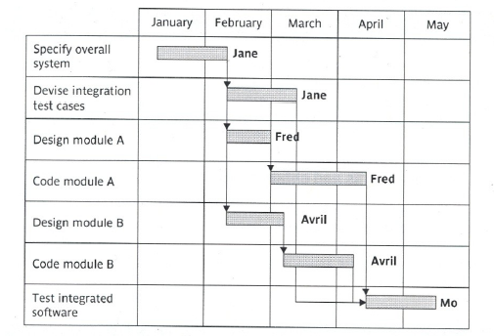
Gant Chart

Slide 22
Step 8‭: ‬Review/publicize Plan‭ ‬
8.1‭ ‬Review quality aspects of the project plan‭.
  Each activity should have‭ ‘exit requirements’‭ ‬or sign off
  requirements‭
  Each activity should have quality criteria‭.
  Quality criteria‭ : ‬are quality checks that have to be passed‭ ‬
  before the product can be‭ ’signed off’ ‬as completed‭. ‬
8.2‭ ‬Document plans and obtain agreement‭.
  all parties understand and agree to the commitments in‭ the plan

Slide 23
Step 9/10‭: ‬Execute plan/Lower-level planning‭
Plans will need to be more detailed for each activity as it‭
becomes due‭
Detailed planning of later stages needs to be delayed because
more information will be available nearer their start‭.
  But it is necessary to make provisional plans for more distant‭
  tasks‭. Why‭?

