Slide 1
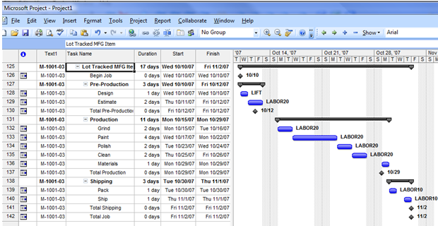
NET481
MS Project Overview
TA. Maram Al-Khayyal

Slide 2
Outline
Introduction to project management.
  Project 2007 can help you manage project time, resources, costs and scope.
Working with tasks.
  how to list tasks in a project, organize them into phases and schedule them.
Managing resources
  how to assign people and equipment to tasks and define working times for resources to ensure effective resource management.

Slide 3
What is Microsoft project(MSP)
A project management is a software program.
It aims to assist a project manager in developing a plan, assigning resources to tasks, tracking progress, managing the budget.

Slide 4
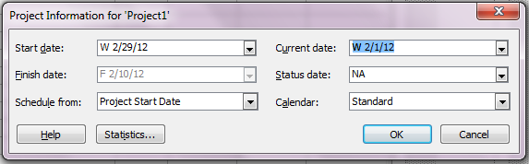
Creating a new project using the project guide
Define the project:
Select File > New.
Click Blank Project in the New Project task pane on the left.
The Project Guide now displays the Tasks pane.
Click Project Information from the Project tab.
Enter the estimated date your project will begin.

Slide 5
Define general working times
The next phase is to define general working times:
In the Project Guide Tasks pane, click Define general working times.
Using the calendar template drop-down menu, select a template that works best for your project.
Click Continue to Step 2.

Slide 6
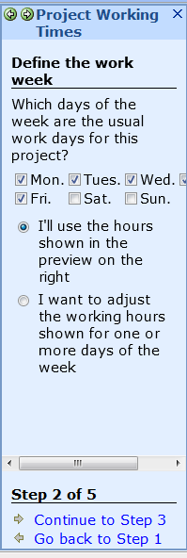
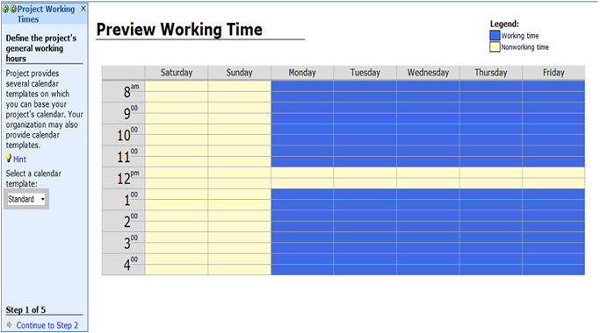
Define general working times

Slide 7
Defining tasks
For each task you have to specify:
Task name.
Duration.
Start and finish dates (Project 2007 fills in the finish date automatically).
Predecessors: whether each task is dependent on the launch or completion of another task.

Slide 8
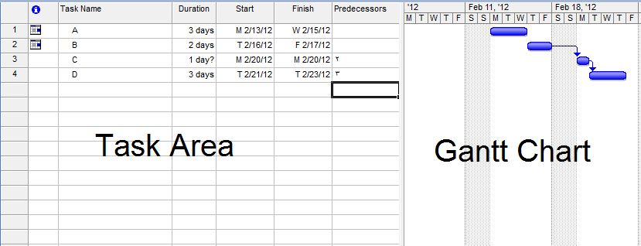
Defining tasks

Slide 9
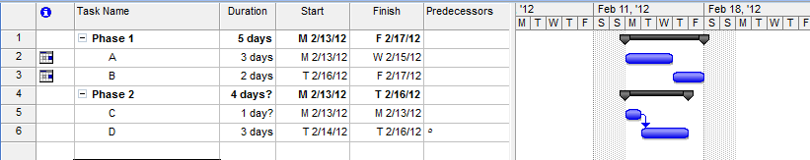
Organizing tasks into phases
One way to make your project plan manageable is to group tasks into phases. Some people like to group tasks that share certain characteristics, whereas others prefer to group tasks by time frame.

Slide 10
Managing resources
A resource is the people, equipment, or materials used to complete tasks in a project.
Most projects involve multiple resources.

Slide 11
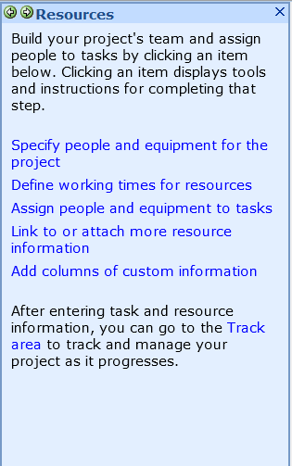
Managing resources

Slide 12
Changing views in Project 2007
Gantt Chart: Consists of a table and a bar chart so you can see both tasks in a written and graphical format.
Network Diagram: Displays your tasks in a flowchart format.
Tracking Gantt: Displays your project's schedule and progress against that schedule

