Slide 1
Chapter 13: Software Quality
Project Management
Afnan Albahli

Slide 2
Quality Concerns
• We need to define what qualities we require of a system.
• We also need to judge whether a system meets our quality requirements (this needs measurements).
• We may want to assess the likely quality of the final system while it is still under development.
• We also will need to make sure that the development methods would produce the quality needed.
  – A potential customer might check that the suppliers were using the best development methods.

Slide 3
The Importance of Software Quality
Quality should be the concern of all the producers of goods and
services, however the special characteristics of SW create special
demands.
  Increasing criticality of SW.
  The intangibility of SW make it difficult to know that a project task was completed satisfactory.
  Accumulating errors during SW development.
For these reasons quality management is an essential part of effective overall project management.

Slide 4
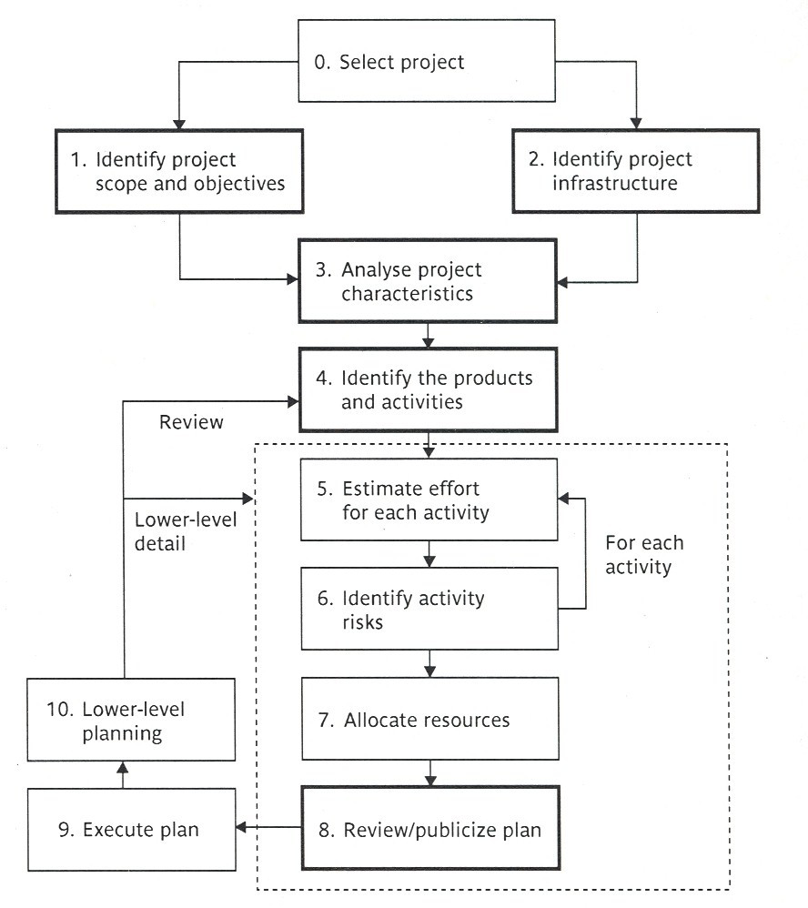
The Place of Software Quality in Project Planning “step wise framework”
Quality will be of concern in all stages of the project but it will be of particular interest at the following steps in bold in the step wise framework.
• Step1
• Step2
• Step3
• Step4
• Step8

Slide 5
The Place of Software Quality in Project
Step 1: Identify project scope and objectives: some objectives could relate to the qualities of the application to be delivered.
Step 2: Identify project infrastructure, within this step, activity 2.2 identifies installation standards and procedures. Some of those will be about quality.
Step 3: Analyze project characteristics, within this step activity 3.2 Analyze other project characteristics including quality based ones.
Step 4: identify the products and activities of the project.
Step 8: Review and publicize plan, at this stage the overall quality aspects of the project plan are reviewed.

Slide 6
Defining Software Quality
Every system has:
Functional requirements: what is the system is to do.
Resource requirements: allowable cost.
Quality requirements: how well the system is to operate.
Example of quality requirements required by the users are:
Usability.
Reliability.
Defining quality is not enough, in order to judge whether a
system meets our requirements, we need to be able to measure
its qualities.

Slide 7
Quality Measures
In order to judge whether a system meets our requirements ,we need to be able to measure its qualities.
A good measure must relate the number of units measured to the maximum possible.
Example:
For the reliability, it could be argued that the less the errors in a program the more reliable it is.
A measure of faults per thousand of lines of code is more useful than the total faults in a program.

Slide 8
Quality Measures (cont’d)
Quality measures are important because they are a way to know when we have been successful to meet a quality.
Measures can be:
– Direct measures: where we can measure
the quality directly.
– Indirect measures: where the thing being measured is
not the quality itself, but an indicator that the quality
is present.
– e.g. the number of enquirers by users received by a help desk about how one operates a particular SW application might be an indirect measurement of its usability.

Slide 9
Quality Specifications
When there is concern about the need for a specific quality characteristic in a SW product then a quality specification with the following minimum details should be drafted:
– Definition “description” of the quality characteristic.
– Scale: the unit of measurement.
– Test: the practical test of the extent to which the attribute quality exists.
– Minimally acceptable: the worst value which might be acceptable if other characteristics compensated for it, where the product would be rejected if had a lower value.
– Target range: the range of values within which it is planned the quality measurement should lie.
– Now: the value that applies currently.

Slide 10
Reliability
Software reliability is defined as: The ability of a system or component to perform its required functions under stated conditions for a specified period of time.
The following are some measurements used to measure the reliability of a product:
• Availability: the percentage of a particular time interval that a system is usable.
• Mean time between failures: the total service time divided by the number of failures.

Slide 11
Reliability
Associated with reliability is maintainability, which is: how quickly a fault, once detected, can be corrected. ”this is from the users point of view”
“the SW development managers” will be concerned about the effort involved.
A key component of this is changeability, which is: the ease with which the software can be modified.
However before an amendment can be made, the fault has to be diagnosed.
Maintainability can therefore be seen as changeability plus anew quality, analysability, which is the ease with which causes of failure can be identified.

Slide 12
ISO 9126
Stands for “International Organization for Standardization.”
There was a lack of agreed on definitions for the qualities of a good software.
This standard was introduced in 1991 to tackle the question of the definition of software quality.

Slide 13
ISO 9126 (cont’d)
ISO 9126 defines six major software quality characteristics:
Functionality: covers the functions that a software product provides to satisfy user needs.
Reliability: refers to the capability of the software to maintain its level of performance.
Usability: which relates to the effort needed to use the software.
Efficiency: which relates to the physical resources used when the software is executed.
Maintainability: relates to the effort needed to make changes to the software.
Portability: relates to the ability of the software to be transferred to a different environment.

